Slide 1

Marqeta Take Home Assignment
Anuj Tiwary

Slide 2
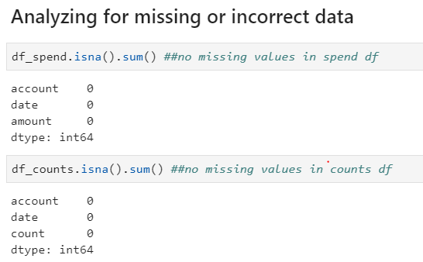
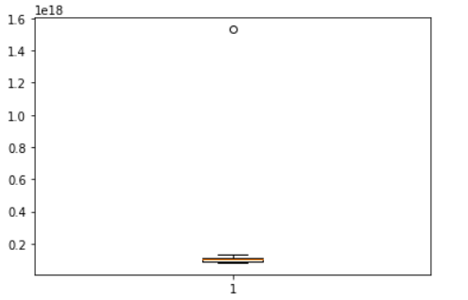
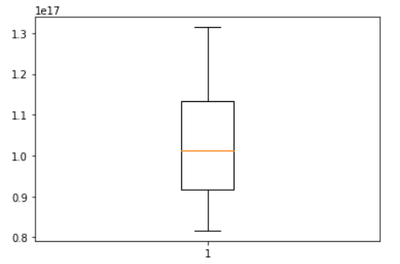
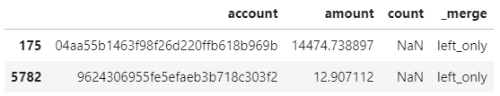
Part 1
Q1. Are there any instances that you believe there to be missing or incorrect data? If so, explain how you dealt with those data points. Explain why you think your choices are reasonable.
Missing Data? There are no missing data points in the two datasets (Table 1 below). However, there was one record which appeared to be incorrect in the spend transaction dataset – details below. Note: There were two accounts in the Spend dataset (Table 2) which didn’t have corresponding records in the Counts dataset. As there were only two out of 10000 records, it wouldn’t make a difference in our analysis and hence were removed.
Incorrect Data? The box plots below depicts an incorrect data point in the date field in the Spend dataset (Fig 1), and no outlier or incorrect data point in the Counts dataset (Fig 2). There were 577 transactions for this account, and all transactions but this one had matching date in Counts dataset, it was assumed that this incorrect data point (1973-04-05) corresponded to the only non-matching date record and hence was replaced with that date (2017-08-06).
Answer the following questions, and accompany with a simple graphic, table, or chart if it helps to answer the question succinctly. Be sure to state any assumptions or logic you might have made to answer the question.
Fig 1. Outlier (incorrect data) in the Spend dataset
Table 1. There are no missing or null records in the two datasets as seen above
Table 2. Two records present in Spend, not present in Counts
Fig 2. No outliers detected in the Counts dataset

Slide 3
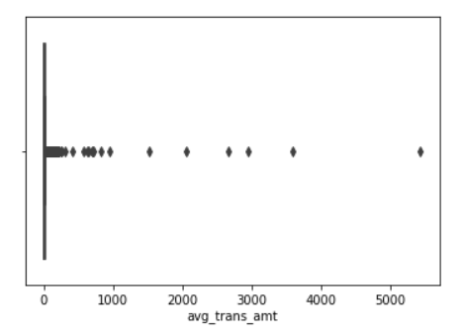
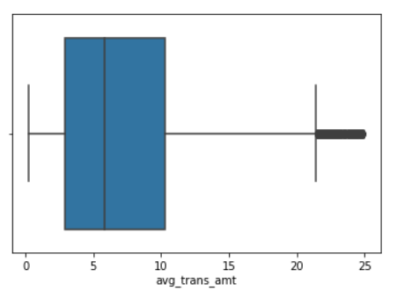
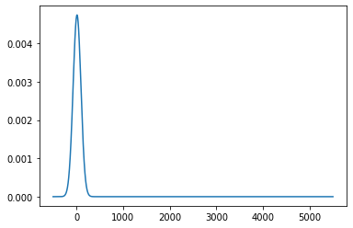
Part 1
Q2. How are the accounts distributed by average transaction size?
The boxplot for average transaction amount (total amount/total number of transactions) shows that the distribution is right-skewed (Fig 3). We see that the middle 50% (median) is squeezed into the left side of plot.
The accounts are distributed in a non-normal distribution (Fig 5) by the average transaction amount. The details around the plot and outlier detection for this distribution is explained in the upcoming slide (slide #5).
Fig 3. Box plot depicting heavily right-skewed distribution
Fig 4. Box plot after removing ‘outliers’ depicting right-skewed distribution
Fig 5. Non-normal right-skewed distribution of the average transaction amount
Table 2. Two records present in Spend, not present in Counts

Slide 4
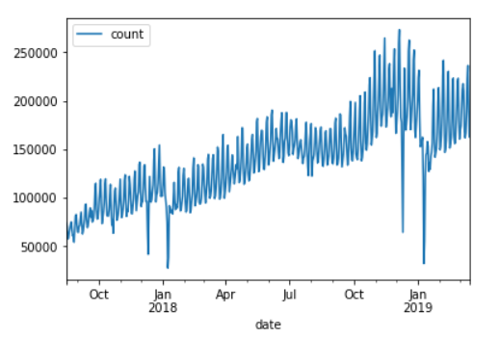
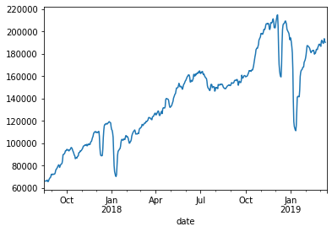
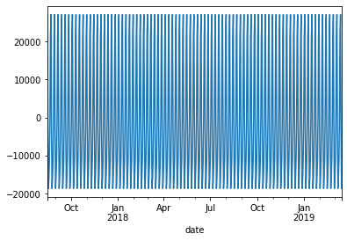
Part 1
Q3. Is there any temporal/time-series pattern to the total transaction volume on a daily/weekly/monthly/seasonal/other basis?
The trend plot (Fig 7 – trend of the total transaction volume) shows that the volume of transactions has an overall upward/increasing trend in the period of analysis – with a spike during the holiday season (November and December).
The seasonal plot depicts that there is a weekly seasonal pattern in our data (Fig 8 – Seasonal plot of total transaction volume) as the pattern repeats itself approximately four times between two consecutive months. Note: The model used in the analysis is additive as the seasonality’s amplitude is independent of the level (mean).
Fig 6. Time-series additive plot of total transaction volume
Fig 7. Trend plot of total transaction volume
Fig 8. Seasonal plot of total transaction volume
Table 2. Two records present in Spend, not present in Counts

Slide 5
Part 2
Q1. What anomalous behavior do you observe? Can you identify any outliers?
There are no outliers on the left side of the tail, and all the outliers are on the right side of the tail. According to the Inter-Quartile Range (IQR) rule, sections contained within the whiskers should account for 99.3% of the data (implying 0.35% could be outside whisker on either side). In this case 683/9999 = 6.83% (refer to the python code for analysis) of the data points are outside the right whisker.
However, these data points cannot be considered outliers as this distribution is skewed right (as stated in slide #3) and the IQR rule holds true only with a normal distribution. Hence, it wouldn’t be useful to say that 6.83% of our data are outliers – if in reality high values are so common in our population, and therefore we’d not remove them or replace them (with median/mean).
What anomalous behavior do you observe? Can you identify any outliers?
Fig 9. Box plot depicting heavily right-skewed distribution
Fig 10. Box plot after removing ‘outliers’ depicting right-skewed distribution

